Slide 1

Week 1 – Introduction to Node.JS (Our Backend for the course)
CPAN 212 – Modern Web Technologies – Harman Mann

Slide 2

What we will go over
What is Node.js
What can Node do
Why use Node
Node Package Manager (NPM)
Node Modules
Node data types

Slide 3

What is NodeJS?
Node.js is an open-source, cross-platform JavaScript runtime built on Chrome's V8 JavaScript engine.
It allows developers to run JavaScript code server-side, enabling the development of scalable and high-performance applications.

Slide 4
A bit of History
Built on the V8 JavaScript engine
What is V8
What's the most popular browser right now? -> Chrome
JS runs on chrome as V8, and because it was so popular and fast people continued to develop for it and it evolved into Node JS
Node can run on Windows, Mac OS, Linux

Slide 5

What Can Node Do?
Generate dynamic page content
CRUD operations
Collect and parse Data
Create CLI applications
Install packages using a package manager

Slide 6

Why Do We Use Node?
Built for reliability
Non-Blocking
Event Driven
Asynchronous
Same Language on Front End and Back End

Slide 7
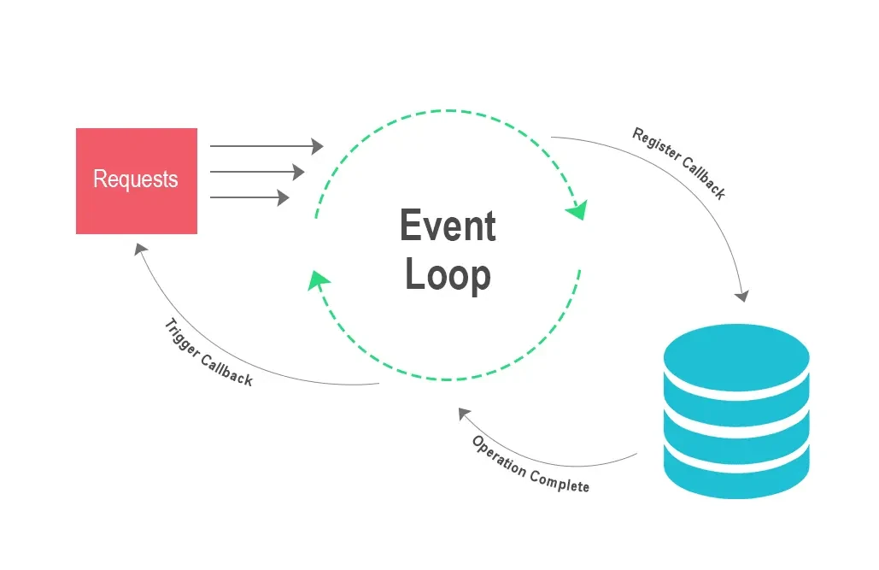
Non-Blocking and Event Driven
Node.js uses a non-blocking, event-driven architecture that allows it to handle concurrent requests efficiently.
Unlike traditional blocking I/O, Node.js enables the server to continue processing other tasks while waiting for I/O operations to complete.

Slide 8
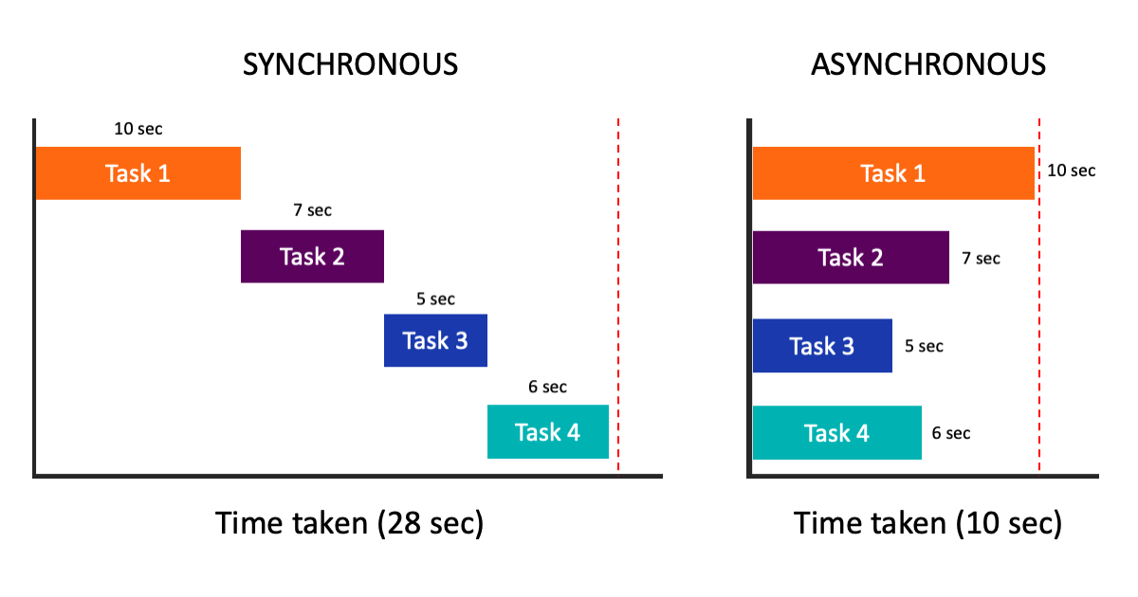
Asynchronous
Node.js is designed for asynchronous programming, allowing tasks to be executed concurrently without waiting for the completion of each operation
This enhances performance by avoiding idle time during I/O operations.

Slide 9
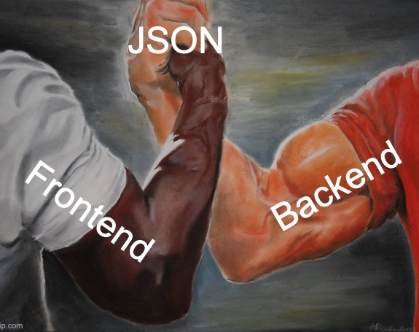
Why MERN
Same Language – that’s it
Instead of tossing multiple languages at you, we will be using 1 in this class
(You could use this courses server for any apps you make in other classes, just find a purpose – i.e React Native class)
A server for a mobile app, for example
A server for a game

Slide 10
Node Package Manager (NPM)
NPM stands for Node Package Manager, a package manager for Node.js, the JavaScript runtime.
Key Features:
Simplifies Package Installation
Enables Version Control
Streamlines Dependency Management
Basic Commands:
npm install: Installs project dependencies.
npm init: Initializes a new project.
npm update: Updates project dependencies.
Community and Impact:
Fosters a vibrant community through the NPM registry, allowing developers to share and contribute to the open-source ecosystem.

Slide 11
Modules in Node
Module is a set of functions you want to include in your application
Node.js has a set of built-in modules which you can use without any further installation.
To include a module, use the require() function with the name of the module

Slide 12

Node Modules
A Node Module is like a mini-program, a self-contained piece of code that performs a specific task. It helps keep our code organized and manageable.
Using a Module:
When we need the tools from our toolbox in another part of our program, we use require() to bring in our module. It's like borrowing tools from a friend.
Why Modules Matter:
Clean Organization: Modules keep our code neat and tidy, making it easier to understand.
Easy Reuse: We can share our toolbox (module) with others or use someone else's to save time.
Simple Maintenance: If we need to update a tool, we only must look in one place.

Slide 13
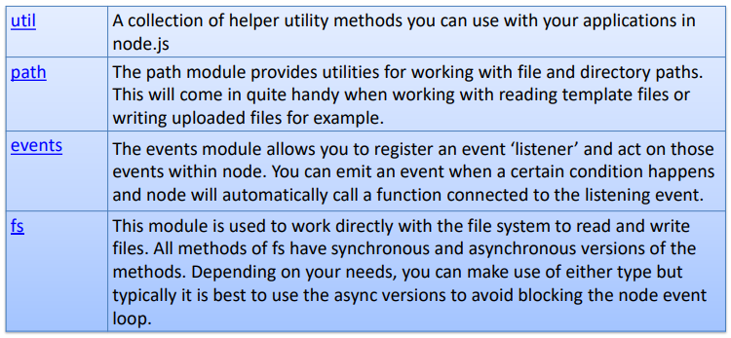
Global Modules
Node includes of modules that are extremely useful as core modules

Slide 14

Node data types
Same as JavaScript
Primitive:
String
Numbers
Boolean
Null
Undefined
Complex:
Object
Array
Function

Slide 15

The End of the Lecture Section
What we will cover next:
Install node
Setup a GitHub account (for submissions)
Setup a repository
Setup vs code with GitHub
Basic coding
Creating your first server
Next week:
Node modules (FS, path)
Setting up endpoints for a server
Setting up basic webpages
Intro to Express

Slide 16

Questions

Slide 17
The rest of the slides:
This is for anyone who couldn’t make it to class
This will include
Code snippets (I recommend trying to write them out and running them)
Modify the code, see what breaks and try learning why it breaks
What isn’t included:
Installing Node
Setting up a GitHub account
Making a private repository for your course work submission

Slide 18
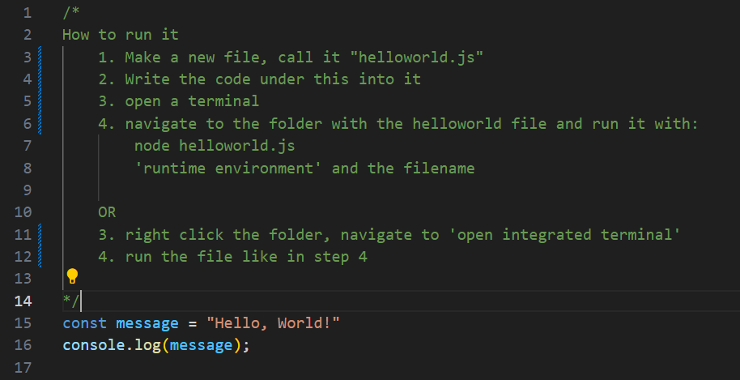
Warm up code: Hello world

Slide 19
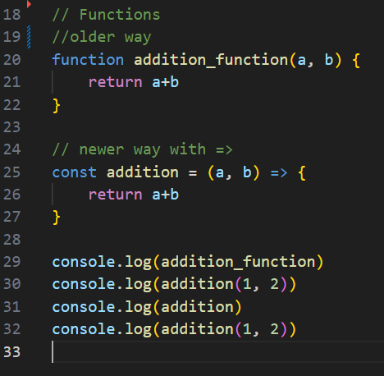
Warm up code: Writing functions with arrows
This is how we are going to write functions (the bottom example)
We will be using this in the server example to start the server and provide us a message saying it has been started.

Slide 20
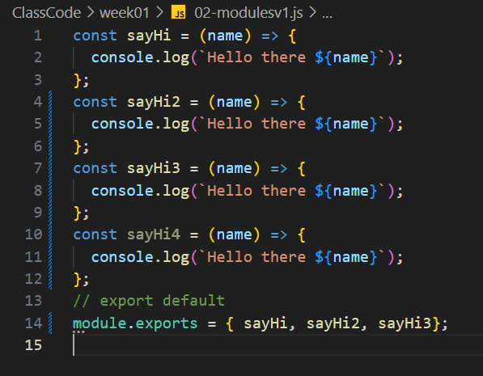
Warm up code: Module -> Its just code in another file
In this file, we have 4 ES6 functions (arrow functions)
The last line, line 14 showcases something called a module. It allows us to call the functions we pass through it in other files
i.e: I make a file that handles all my basic math operations, with each function doing one of the basic arithmetic operations (addition, subtraction etc)
I can pass this onto another file and give it the operations
This example will be on the next slide

Slide 21
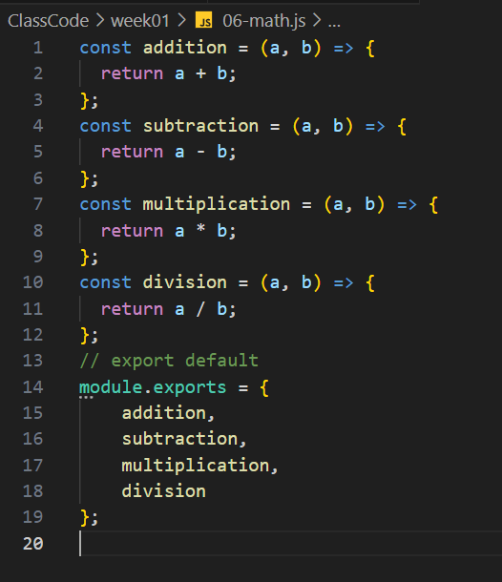
Warm up code: Arithmetic Example
Aside from forgetting error handling, this is the skeleton of the first file, the arithmetic.js file

Slide 22
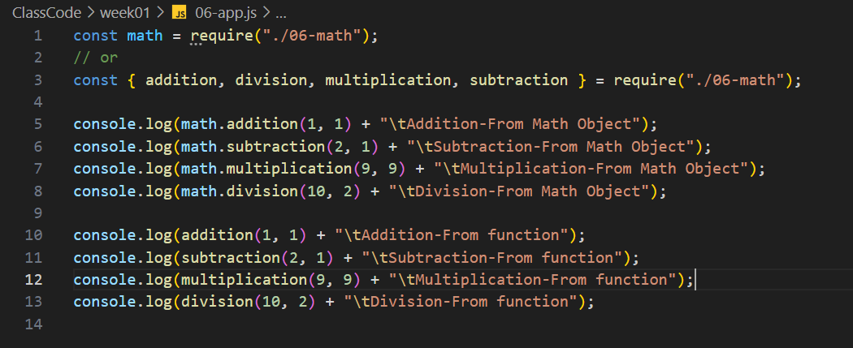
Warm up code: Arithmetic Example
And here is the example. We wrote a file called math.js and called it into our app.js file and are using its functions to help our app with more functionality
That’s what a module is, a file, a file with code to do specific operations and

Slide 23
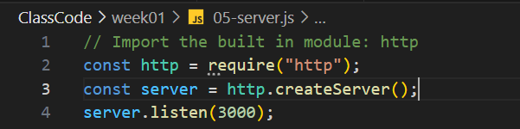
Warm up code: Creating a node server Part 1: The bare minimum
Here is the bare minimum to get a server up and running. The http module is a built-in module that allows us to create a server
We assign the createServer to essentially start up an operation node to have our app be available for the network
The “listen” call will up the app into a state of reactive operations, where it waits for something to call to it before doing something
The Call to 3000, which is called a PORT, is to define an exact location of where we are sending it to -> Think about phone calls/ web domains (next slide for the example)

Slide 24
Warm up: So, the Listener and the Port
So, Think about when you make a phone call. We dial a number, it connects to our service provider, and it establishes a connection to the person on the other end. Specifically, the unique number given to them.
Similarly, in web, we call to a specific domain we want to call. We as consumers see something like “youtube.com”, but the way the network and our service providers see it: you want to connect to a specific server/computer

Slide 25
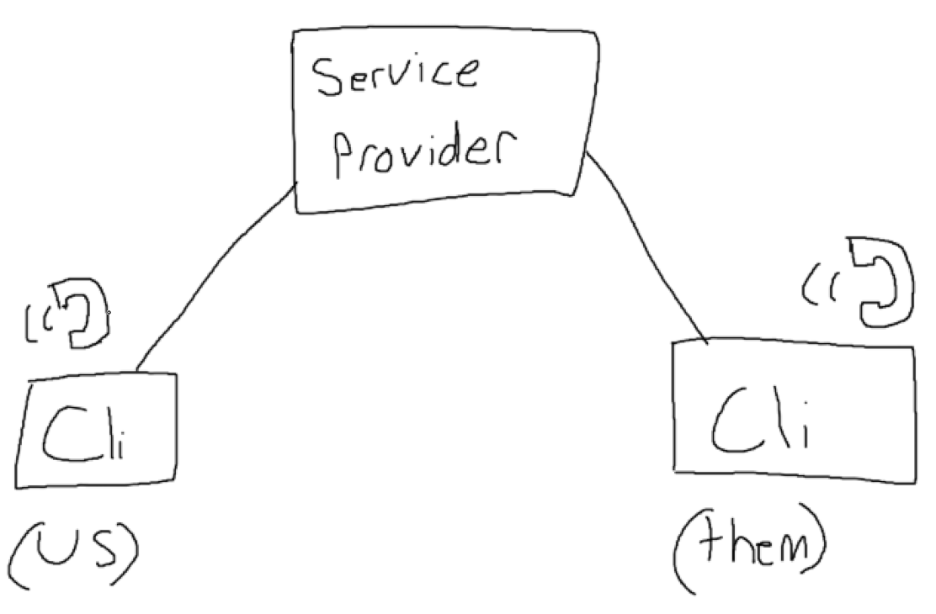
(I swear, the drawings were better in class)
So, you as a Client are trying to call someone
You dial the number; it goes to our S.P and they find who its going to
Think about this deeper:
We dial the number
Hear a dial tone, wait for someone to pickup
And receive a response:
They pick up and say hi
They don’t pick up “sry busy”
Their service is down

Slide 26
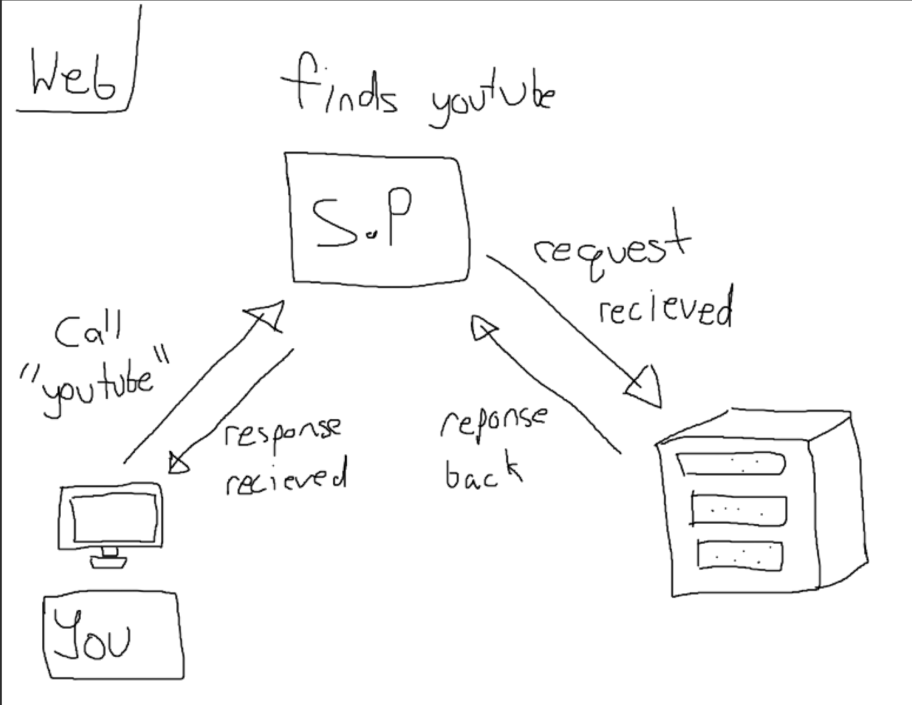
(I swear, the drawings were better in class)
So, you as a User trying to access a website
You enter the domain; it goes to our S.P and they find who its going to
Think about this deeper (the words here matter):
We request access to the domain (youtube.com)
We wait for it to load
And receive a response:
Webpage loads (OK: 200)
Webpage error (ERROR: 404)
Webpage error (ERROR: 401)
Server is Down (ERROR: 500)
Might be on your test

Slide 27
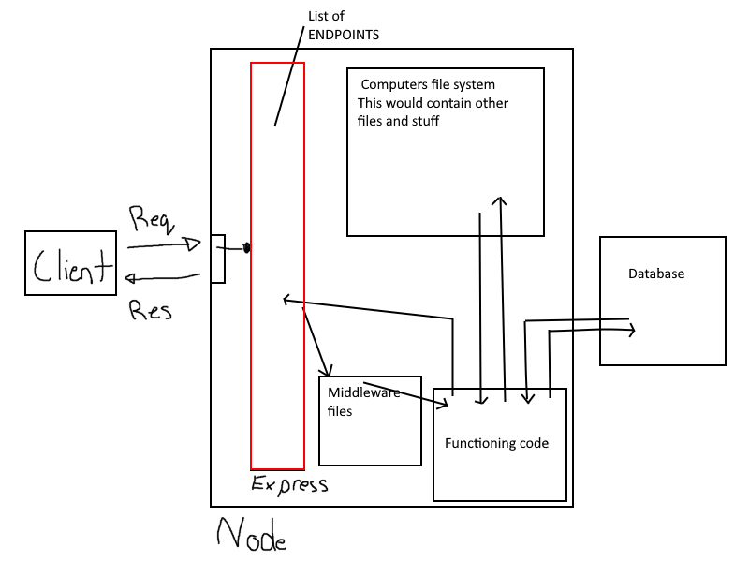
The web server Diagram (A better example in class – broken down by weeks)
In this class we are focusing on code for the backend
I will use HTML, CSS and Javascript for frontend stuff, but for you guys, I want some React for your work (just do some practice)
Most of your marks will be towards the backend stuff

Slide 28
Now, A Node server with some functions
Let's make a small, quick little server. It will handle requests, endpoints to specifically:
/
/about
/contact_us
/login
/register
/logout
Error handling for anything nonexistent in our site
(this is more towards next week; I just want to show it in advance)

Slide 29
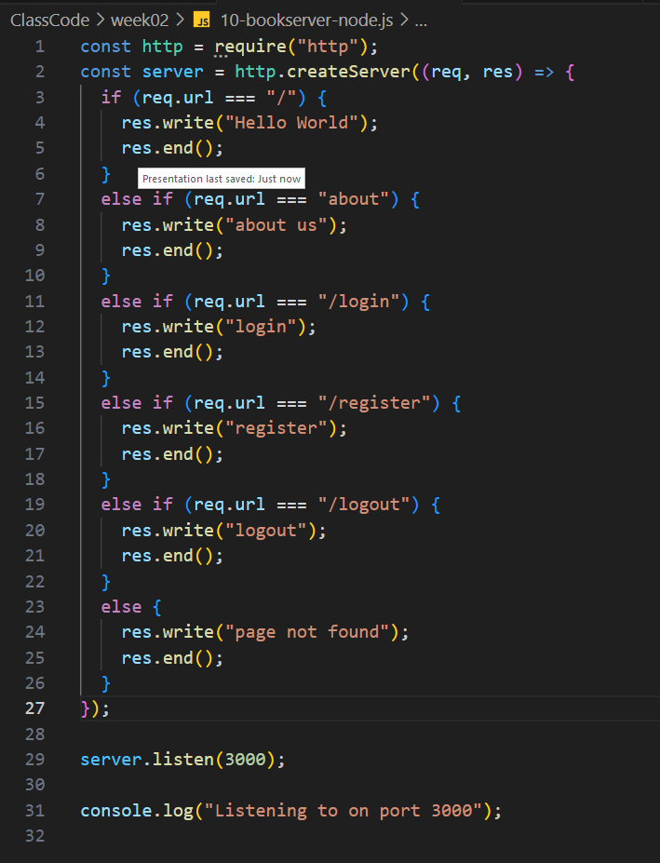
Here is a server file
After we ‘createServer’ we extract the request object (req) and check for the key of url.
We do an if check on the paths we think we need, the ones listed from the last slides, the “endpoints” and we check them off
After we get the endpoint, we must send back a res object
Try it out, what happens if we don’t have a response object (res)
What happens to the loading page (it should load forever, because its waiting for a response)
We will get into the keys that exist in the req and res objects in next weeks class

Slide 30
Questions – I will put this one on Blackboard in a discussion (probably)

Slide 31
A little extra
After next weeks class, I will start slowly posting YouTube links to material we have covered incase someone needs a different explanation, different examples, or just like watching content on YouTube for explanations.
(Its ok, that’s how I was, I preferred videos from YouTube over lectures most of the time)

Slide 32
The tutorials talk
There are 2 ways I see people following tutorials.
Blindly following them to complete them, WITHOUT actually understanding what they are
Watching the video for a specific lesson, for a specific thing you needed.
Here’s my thing about it, you can use tutorials, but if you don’t know what's going on, I don’t know what to mark you for.
(I bring this back to a game development example -> go through tutorials for specific features to build your game)
How to move
How to make an enemy

